Slide 1
Lead Score Case Study
Analysis presentation
Team:
SHASHANK SRIVASTAVA
SOWMMYA TANGUDU
SUDHESH PRABHU

Slide 2
Problem Statement
An education company named X Education sells online courses to industry professionals. On any given day, many professionals who are interested in the courses land on their website and browse for courses. The company markets its courses on several channels. People land on website and browse courses, fill up a form or watch a video.
Once people fill up a form and provide email or phone number, they are called. Later sales team contact them through calls or email. Through this process some of the leads get converted. Usually the conversion rate at X education is 30%
The company wants to identify most potential leads or ‘Hot Leads’. If they successfully identify this set of leads, the lead conversion rate should go up as the sales team will now be focusing more on communicating with the potential leads rather than making calls to everyone.
The objective is to select the most promising leads, i.e. the leads that are most likely to convert into paying customers through a machine learning model. So that conversion rate could go up. The CEO wants the target lead conversion rate to be around 80%
We have been provided with past data of leads of around 9000 data points. This dataset contains various attributes related to a lead which may or may not be useful in identifying Hot leads. The target variable is ‘Converted’ which tells whether a past lead was converted or not.
We will be building a logistic regression model to learn from this dataset and identify potential leads that will get converted.

Slide 3
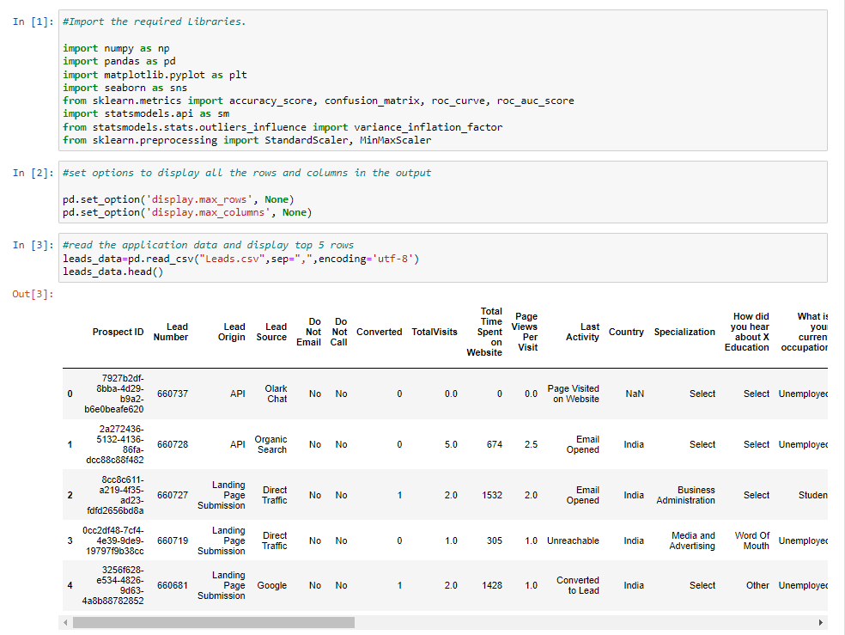
Step 1: Importing data from csv file and inspecting the data
Import all required libraries and read the dataset into a pandas data frame.

Slide 4
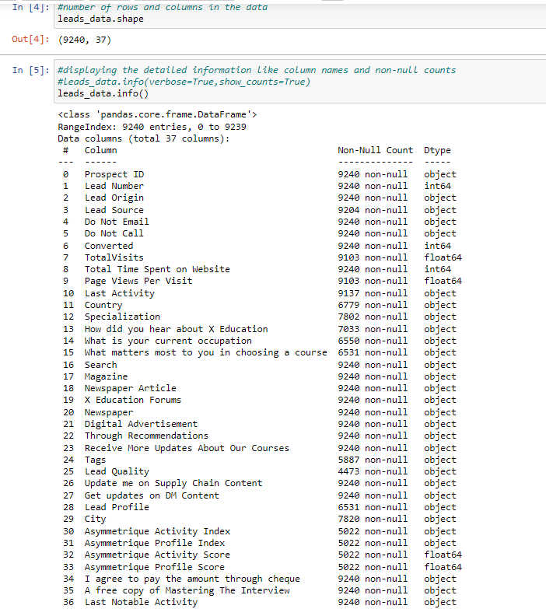
Step 1: Importing data from csv file and inspecting the data
Inspect the data size and all the attributes and its data types.

Slide 5
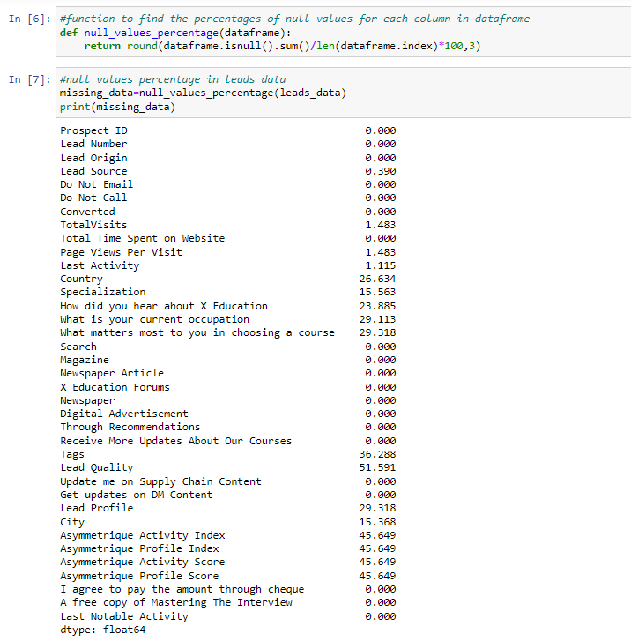
Step 1: Importing data from csv file and inspecting the data
Checking for data quality and null values

Slide 6
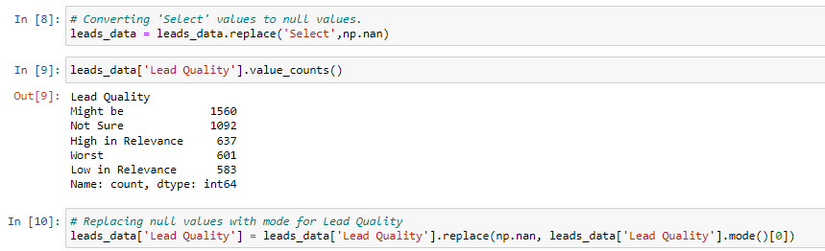
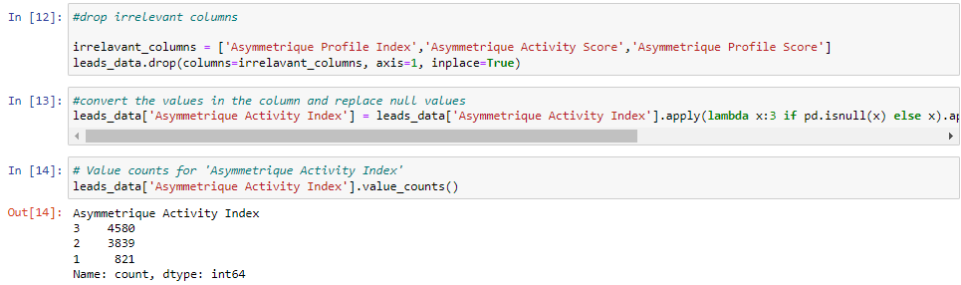
Step 2: Data preparation
Treating Null values
Replacing ‘Select’ value with ‘Not Known’. Treating Lead Quality column for null values(replacing null with mode value)
Dropping irrelevant columns.. And null value treatment for 'Asymmetrique Activity Index’ clumns

Slide 7
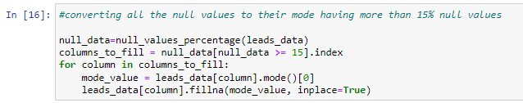

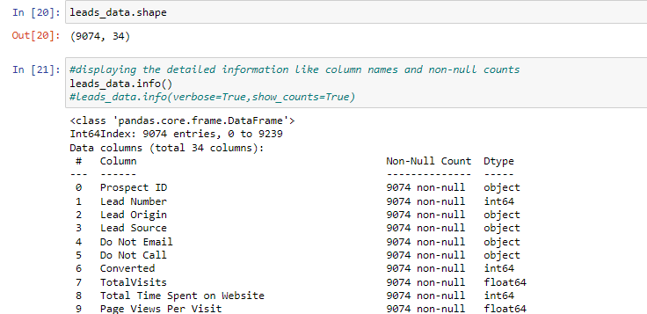
Step 2: Data preparation
Treating Null values: Converting all Null values to their mode values for attributes having more than 15% null values.
Dropping data having null values less than 2%
Finally checking shape of data frame and info.

Slide 8
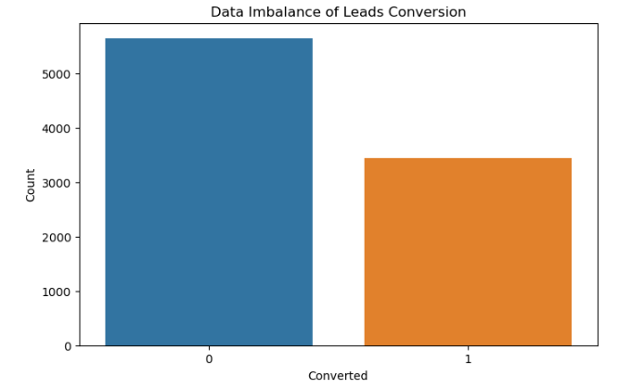
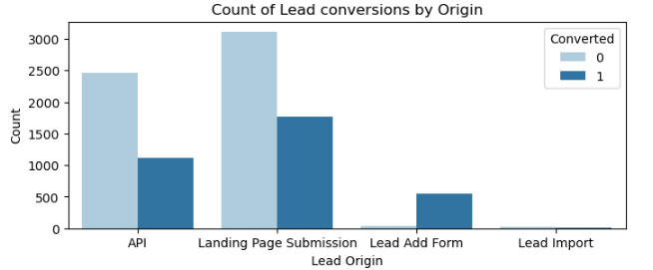
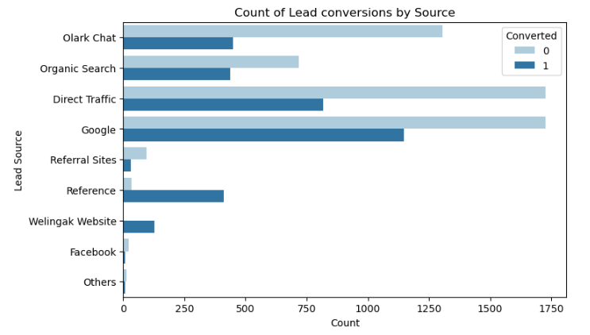
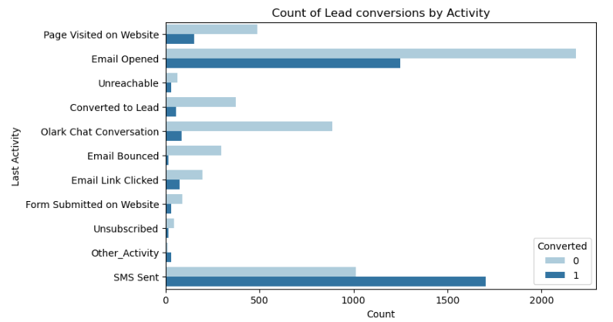
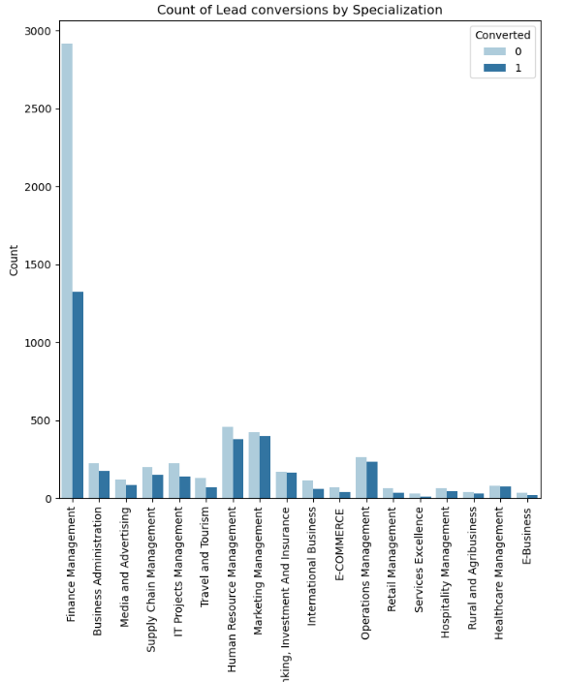
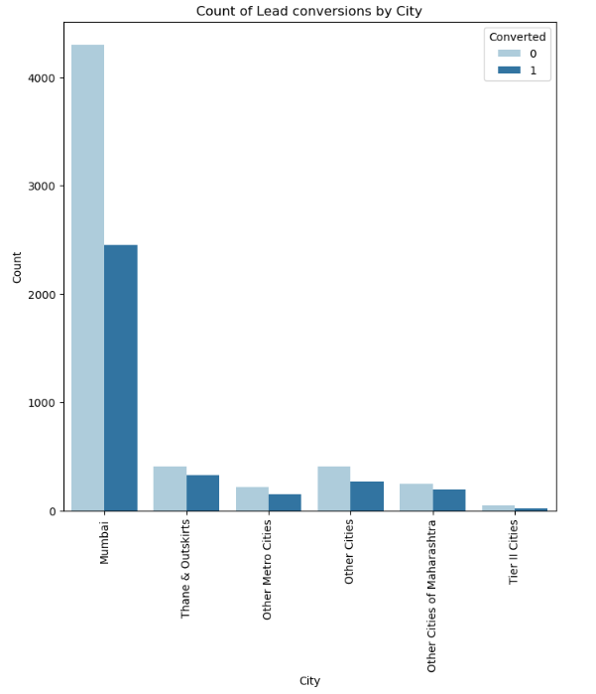
Step 3: Exploratory Data Analysis (EDA)
Data imbalance of Leads Conversion Lead Conversion by Origin Leads Conversion by Source(Replace google with Google and added Others)
Leads conversion by Last Activity Leads Conversion by Specialization Leads Conversion by City

Slide 9
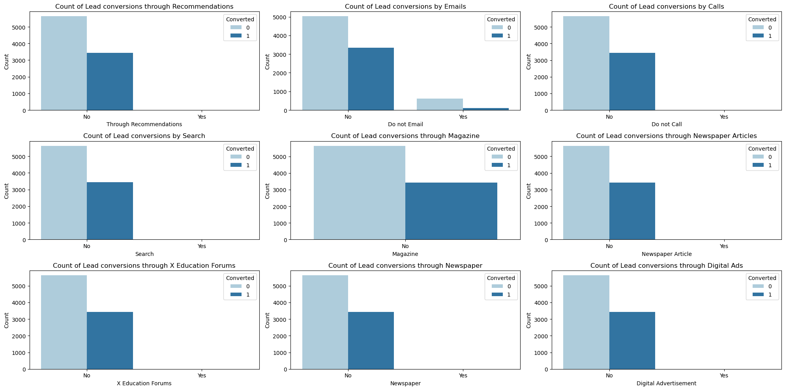
Step 3: Exploratory Data Analysis (EDA)
Visualization of Lead conversion through different channels.

Slide 10
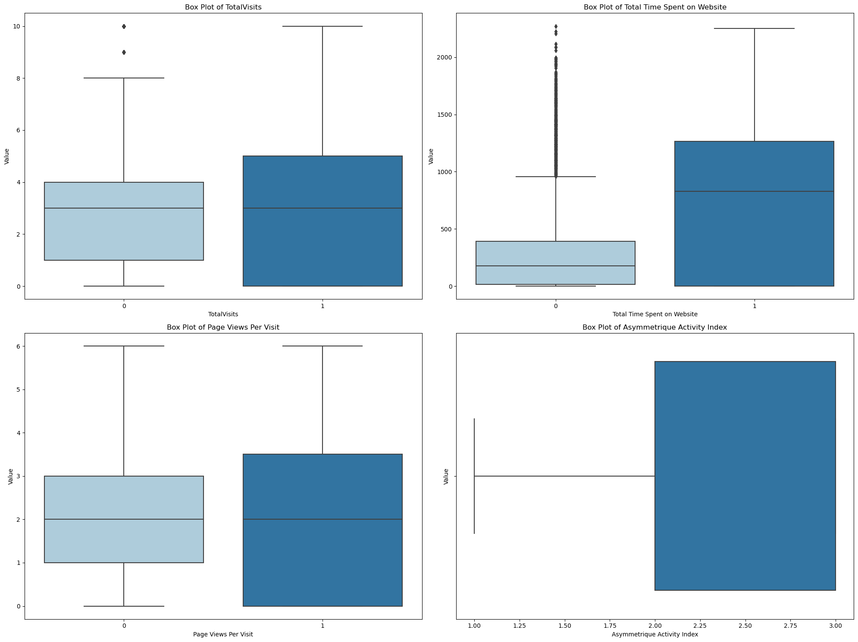
Step 3: Exploratory Data Analysis (EDA)
Box plot of total visits Time spent on Website, Page views per visit and Asymmetrique Activity index.

Slide 11
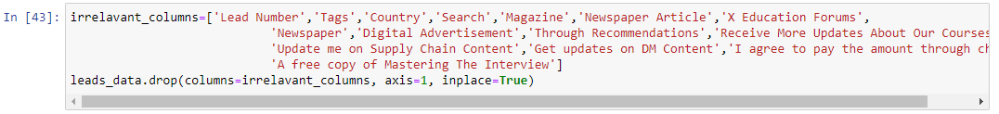
Step 3: Exploratory Data Analysis (EDA)
Findings From Exploratory Data Analysis
37% of Leads are getting converted. 62% are not getting converted.
Origin: Most of the Leads are coming from API and Landing Page submission. But Leads from ‘Lead Add Form’ have higher possibility of getting converted.
Source: Most of the Leads are coming from Google Search, Direct Traffic and Olark Char. Few Leads are coming from referrals and Reference sites as well. Very few leads aare coming from Facebook and other sources.
Last Activity: Last Activity on the website is mostly Email opened or SMS Sent or Olark chat.
Country: Most of the Leads are from India.
Specialization: Very high number of Leads are from Finance Management. But conversion rate is less than 50%
How did you hear about X education: Most of the leads are hearing about X education through online search.
City: Very high number of leads are coming from Mumbai. Other cities include Thane & outskirts, Other Metro cities etc. Conversion Rate is higher in other cities compared to Mumbai.
Box plot of Total time spent on website shows that, highet the time spent on website, there is higher chances of the leads getting converted.
Similarly we visualized Leads conversion by different attributes gives in the dataset some of which are given in previous slides.
We also dropped some irrelevant columns from the dataset for model building.

Slide 12
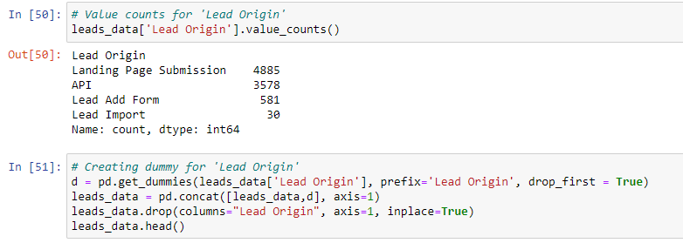
Step 4: Adding dummy variable for categorical variables
Creating dummy variables for categorical variables for machine learning modeling:
We created dummy variables for Lead Origin as it is a categorical variable and has 4 distinct values. So creating a dummy variable will convert this column into a 1/0 column which will be better for machine learning model.
Similarly we created dummy variables for below attributes:
Lead Source
Do Not Email
Do Not Call
Specialization
Last Activity
How did you hear about X Education
What is your current occupation
What matters most to you in choosing a course
Lead Quality
Lead Profile
City
Last Notable Activity

Slide 13
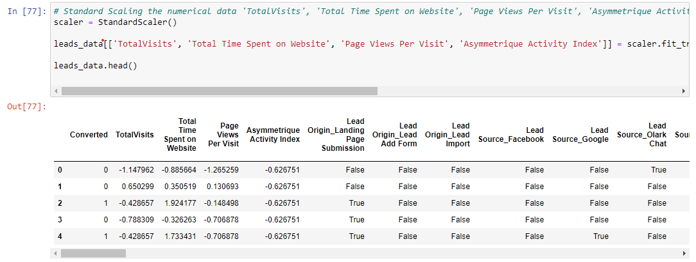
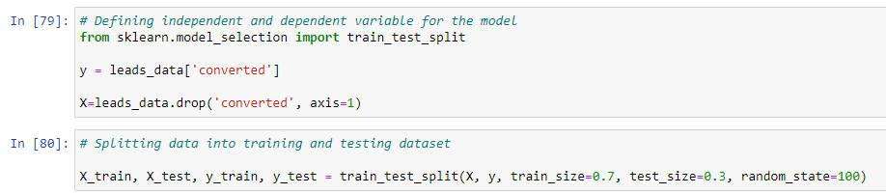
Step 5: Test & Train data split
First step before running a machine learning model is to standardize numerical variables and split data into test and train data for both dependent and independent variables

Slide 14
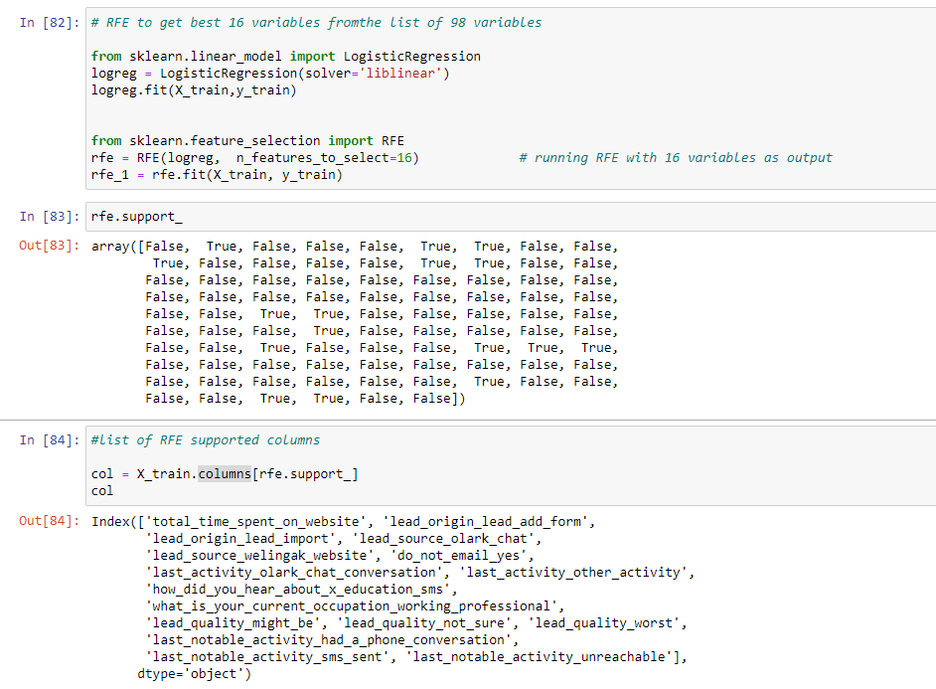
Step 6: Recursive Feature Elimination
Currently our Train data contains 86 variables. We need to eliminate some of the less important attributes from our dataset for training the model. So we are using Recursive feature elimination technique to select best 16 features from the list of 86 features.
Recursive feature elimination (RFE) is a feature selection technique that helps to choose the best features from a given set. It works by building a model on all the given features, removing the least useful predictor, and then building the model again. The algorithm uses an external estimator to assign weights to features, and then prunes the least important features from the current set. This process is repeated recursively until the desired number of features is selected.

Slide 15
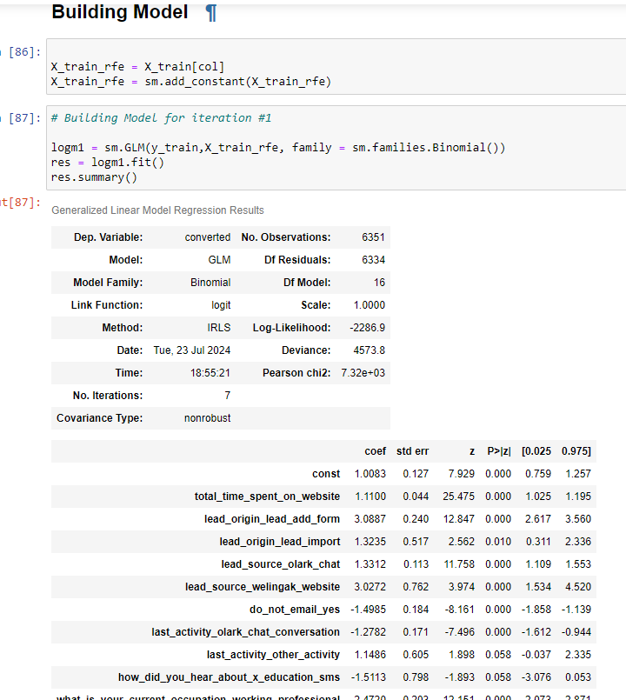
Step 7: Building the model
We built the model with 16 variables checked the summary of the model. As we can see from the summary lead_source_welingak_website, lead_origin_lead_add_form and lead_quality_worst have very highest coefficients in magnitude, indicating their significant impact on the lead conversion probability.
Also last_notable_activity_had_a_phone_conversation has a higher p value compared other variables.

Slide 16
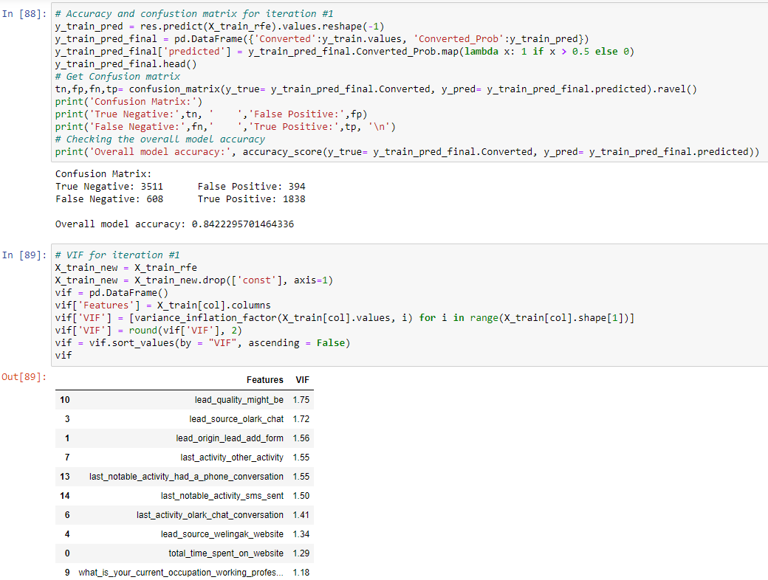
Step 7: Building the model
We also looked at confusion matrix to check accuracy of the model. As seen from below the first model had a accuracy of 84%. We also calculated VIF of variables to check the multicollinearity of the model. After 1st iteration we dropped ‘last_notable_activity_had_a_phone_conversation’ variable because of its high p-value.

Slide 17
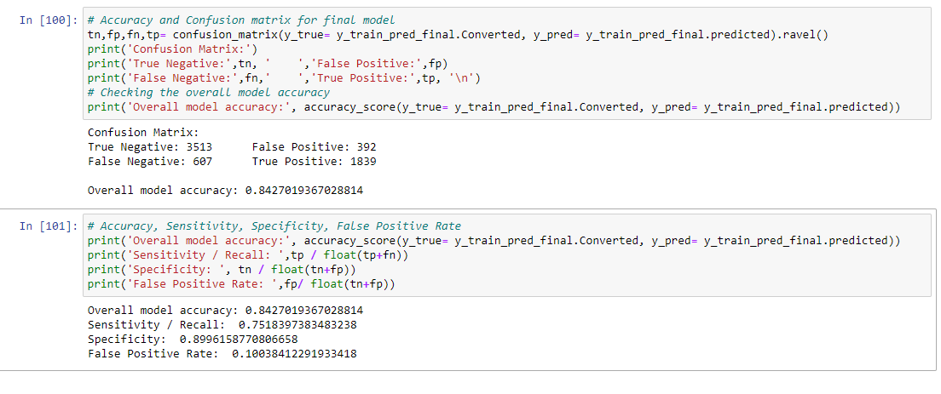
Step 7: Building the model
We repeated the first step of model building with remaining 15 variables and again got an accuracy of 84%. We dropped 'how_did_you_hear_about_x_education_sms’ variable after 2nd iteration because of its high p-value and ran our final model. Similarly ran 3rd iteration.
We ran the final model with the remaining variables and got our final model. Final model had an accuracy of 84%.
Other metrics for the model like sensitivity, Specificity and False Positive Rate are given below:

Slide 18
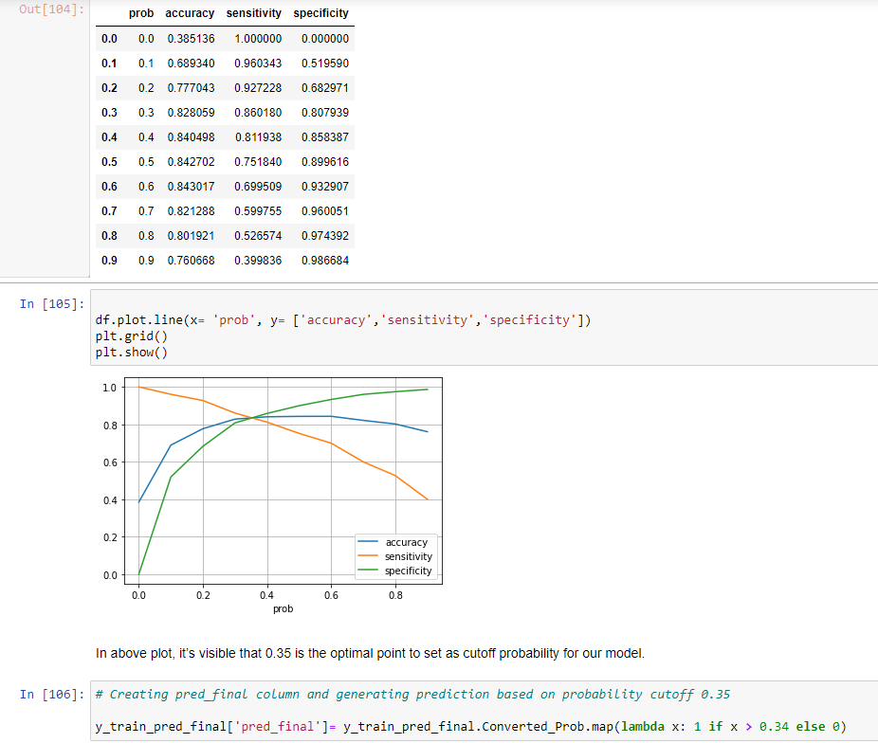
Step 8: Finding optimal cut-off for prediction
Next step is to find the optimal cut off value for prediction to identify whether a lead con be converted or not. We calculated accuracy, sensitivity, specificity for different values of probability from 0.0 to 0.9. By plotting accuracy, sensitivity and specificity we identified 0.35 as optimal point to set as cut-off probability for our model.
Using this cutoff point we calculated predicted value of converted for train data set.

Slide 19
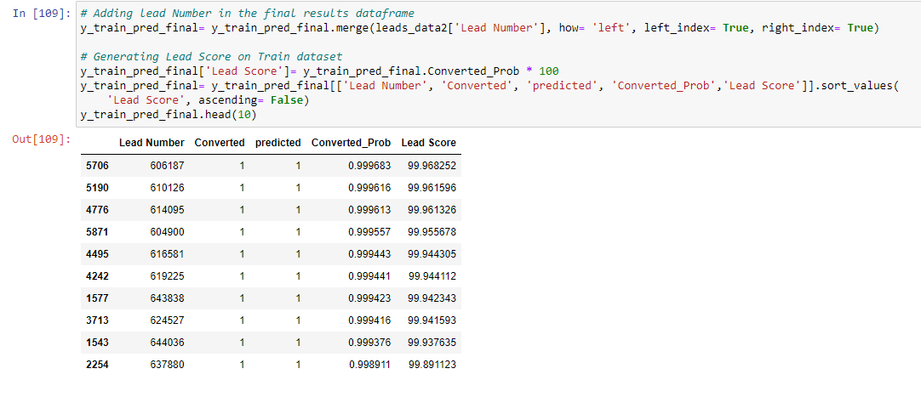
Step 9: Model evaluation on Train and Test data
Final step is to create a Lead Score, a value between 0 and 100 based on predicted value from our model and evaluate the predicted value with actual value of Converted. Below id the final Lead Score and predicted values for train data.

Slide 20
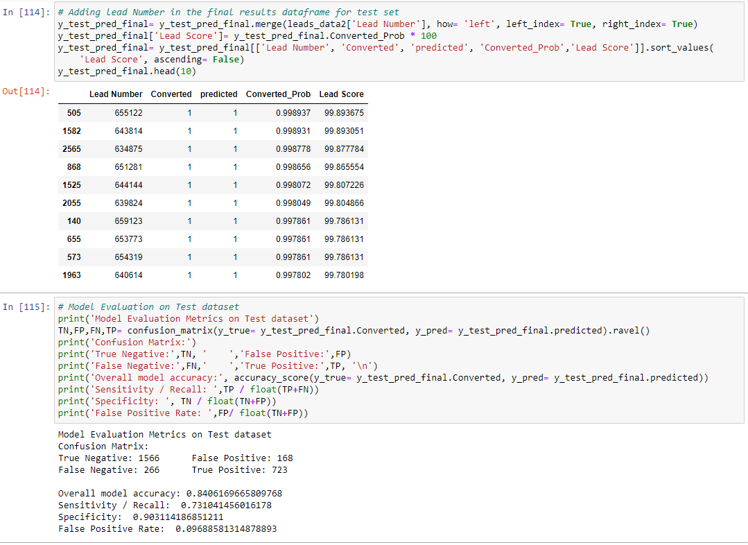
Step 9: Model evaluation on Train and Test data
Similarly added Lead Score for the test data set using our final model and evaluated the model on test dataset. Final model also had a accuracy of 84% on test data and False positive rate of around 9%.

Slide 21
Final findings
Variables like lead_origin_lead_add_form, lead_source_welingak_website and lead_source_olark_chat have significant positive impact on lead conversion possibility
Variables like lead_quality_worst, lead_quality_not_sure and lead_quality_might_be have high negative impact on lead conversion possibility.
In order to increase conversion rate to 80%, X Education must focus on getting more leads from lead_add_form, welingak and olark_chat. And also aggressively contact leads from these sources to convert them
Similarly X Education must try to get better quality of leads. Lead quality is significantly impacting the conversion rate. Lead quality of worst, not sure or might be have negative impat on conversion rate. So it is better to avoid leads from with these lead qualities.
The sales team should be given leads from sources which positively impacts conversion rate and avoid leads which are negatively impacting the conversion rate.

